Slide 1
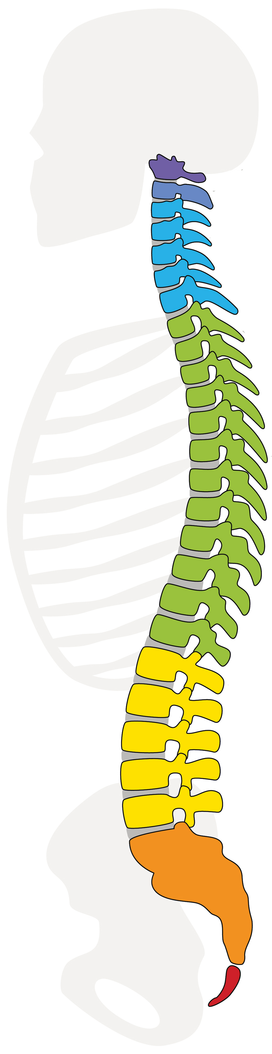
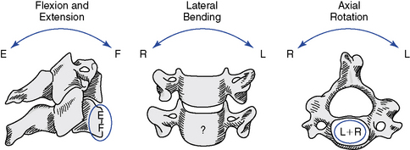
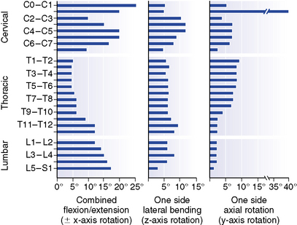

Improved Spine Modeling and Tracking
I2S
3 sensor / n segments model:
sensors at turning points /
spinal transition zones
chain of $n$vertebral segments
with lenght function $l\left(n\right),$ $l: ℕ⟶ℝ_{≥0}$
(1) interpolate rotation and position between sensors
(2) decompose & distribute total spine rotation among joints according to a RoM distribution $RoM(n),$ $RoM: ℕ⟶ℝ_{≥0}$
“Clinical biomechanics of the spine”, White, A. A., & Panjabi, M. M. 1990

Slide 2

Spine Modeling and Tracking – cont‘d (1)
(1) inter-sensor interpolation
intuitive: parametric 3d$C^{2}$ splines on position data
s$\left(τ(n)\right), s:ℝ_{≥0}⟶ℝ^{3}, τ(n)=\frac{\sum_{0}^{n}{l(n)}}{\sum{l(n)}}∈[0, 1]$
- positions from inertial sensors ☹
+ $C^{2}$ between support positions ☺
- yields position-induced segment rotations ☹
interpolation based on orientation data:
$slerp(q_{0},q_{1},τ)$, $slerp:ℝ_{≥0}⟶$ $SO(3)$, $τ∈[0, 1]$
+ orientations from inertial sensors ☺
- def. locally between two rotations, no “spline behavior“ ☹
~ yields length-induced positions (?)
SLERP-splines: use $slerp$ to construct bezier splines on the surface of the 4d unit sphere where quaternions live
+ $C^{2}$ between support orientations ☺
combine both approaches:
position splines + orientation splines
(!) solution is non-unique ➔ optimize within tracking framework!
(joint connections constraints)
I2S
slerp
spline
slerp

Slide 3
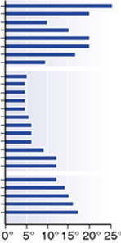
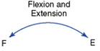

Spine Modeling and Tracking – cont‘d (2)
s
(2) rotation distribution over vertebral segments
idea: “weight the interpolated rotations found with (1) according
to the RoM distribution of a normal, healthy spine“
➔ natural curvature (?)
technically:
first: decompose 3d rotation into its 1d components
(➔ isolate twist / axial rotation, otw. inducing swing,
using e.g. swing-twist quaternion decomposition)
➔ address individual RoM table per axis
second: remap the interpolation parameter
➔ “weighted“ interpolation along the curve length
➔ requires the RoM distribution to be a (discrete) pdf
➔ we define ${ τ}^{∗}\left(n\right)=$ $\sum_{k=0}^{n}{RoM(k)}$via the cdf
and use ${ τ}^{∗}$ as the new spline parameter
finally:
optimize interpolated vertebral positions and orientations as (virtual) tracking states
➔ joint connection constraints + intervertebral (physical?) RoM constraints + ???

Slide 4
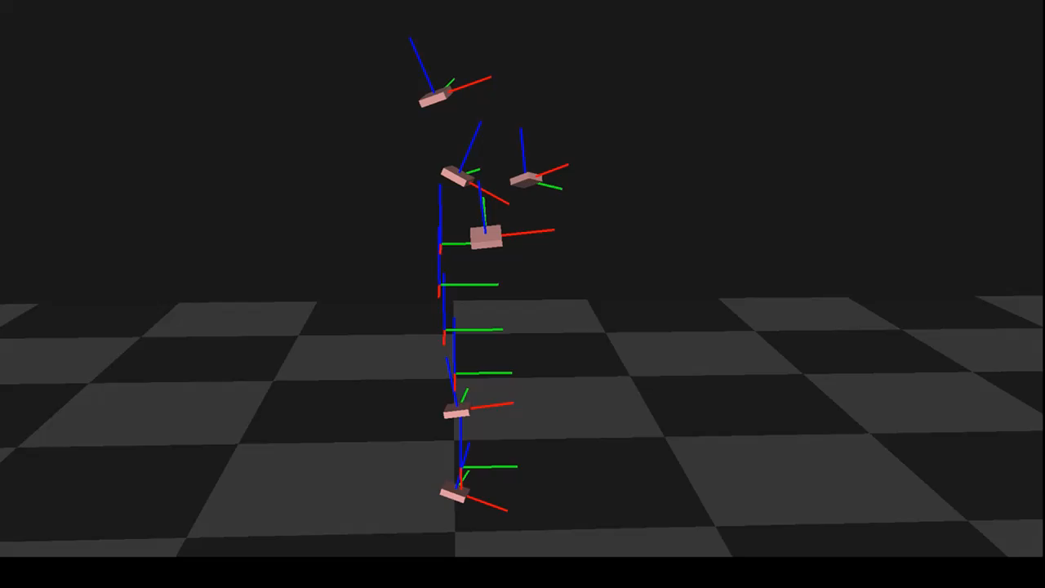
Spine Modeling and Tracking – Visualization
s

